Slide 1
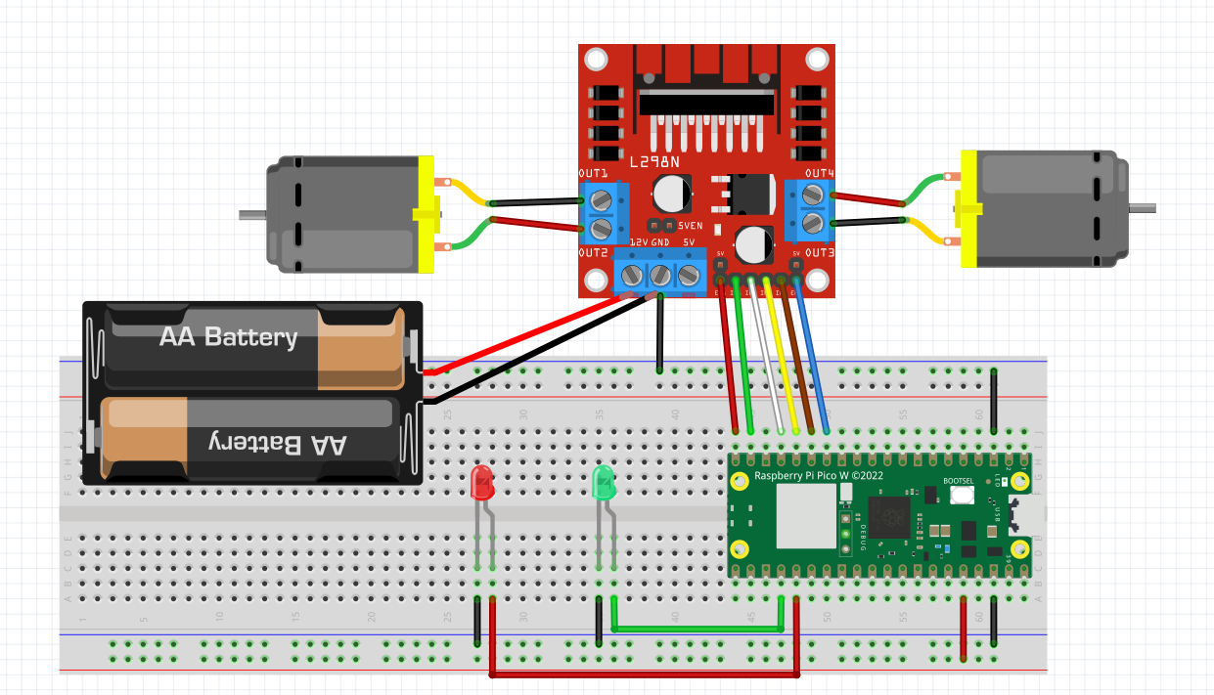
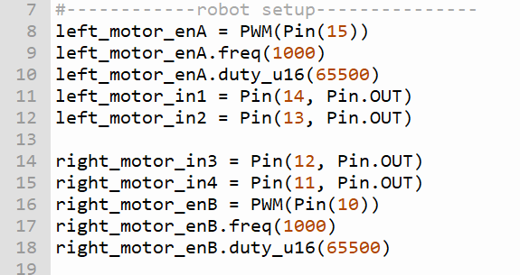
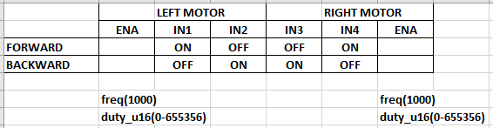
WIRING DIAGRAM OF TEST ROBOT
ROBOT ORIENTATION
LEFT MOTOR
RIGHT MOTOR
Follow the wire colour in this diagram
15 14 13 12 11 10
ENB

Slide 2
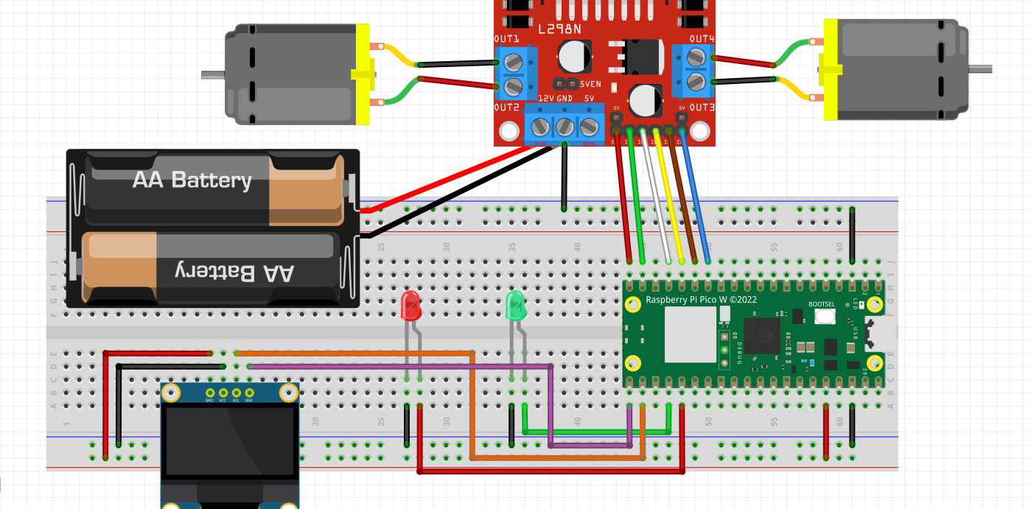
Vcc Gnd SCL SDA
SCL – Pin 17
SDA – Pin 16

Slide 3

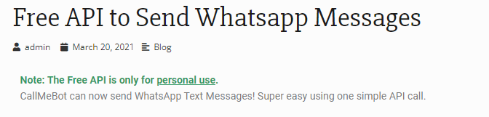
This is the website to go to setup CallMeBot
https://www.callmebot.com/blog/free-api-whatsapp-messages/
The message to send must not contain spaces.
All spaces must be replaced with _
E.G
This is a test
MUST BE SENT AS
This_is_a_test
txt = "I like bananas" x = txt.replace(" ", “_") print(x)
I_like_bananas

